Slide 1



Students:
Alaa Ibrahim Al-hajar
FullStack PHP WebDevelopment
Capstone-project
2022/2023
____________________________
Supervisor:
Bisharah Estephan
جامعة الحسين التقنية
Al Hussein Technical University
H.T.U

Slide 2


Outline
Introduction
Problem Statement
Design Models
Demo

Slide 3
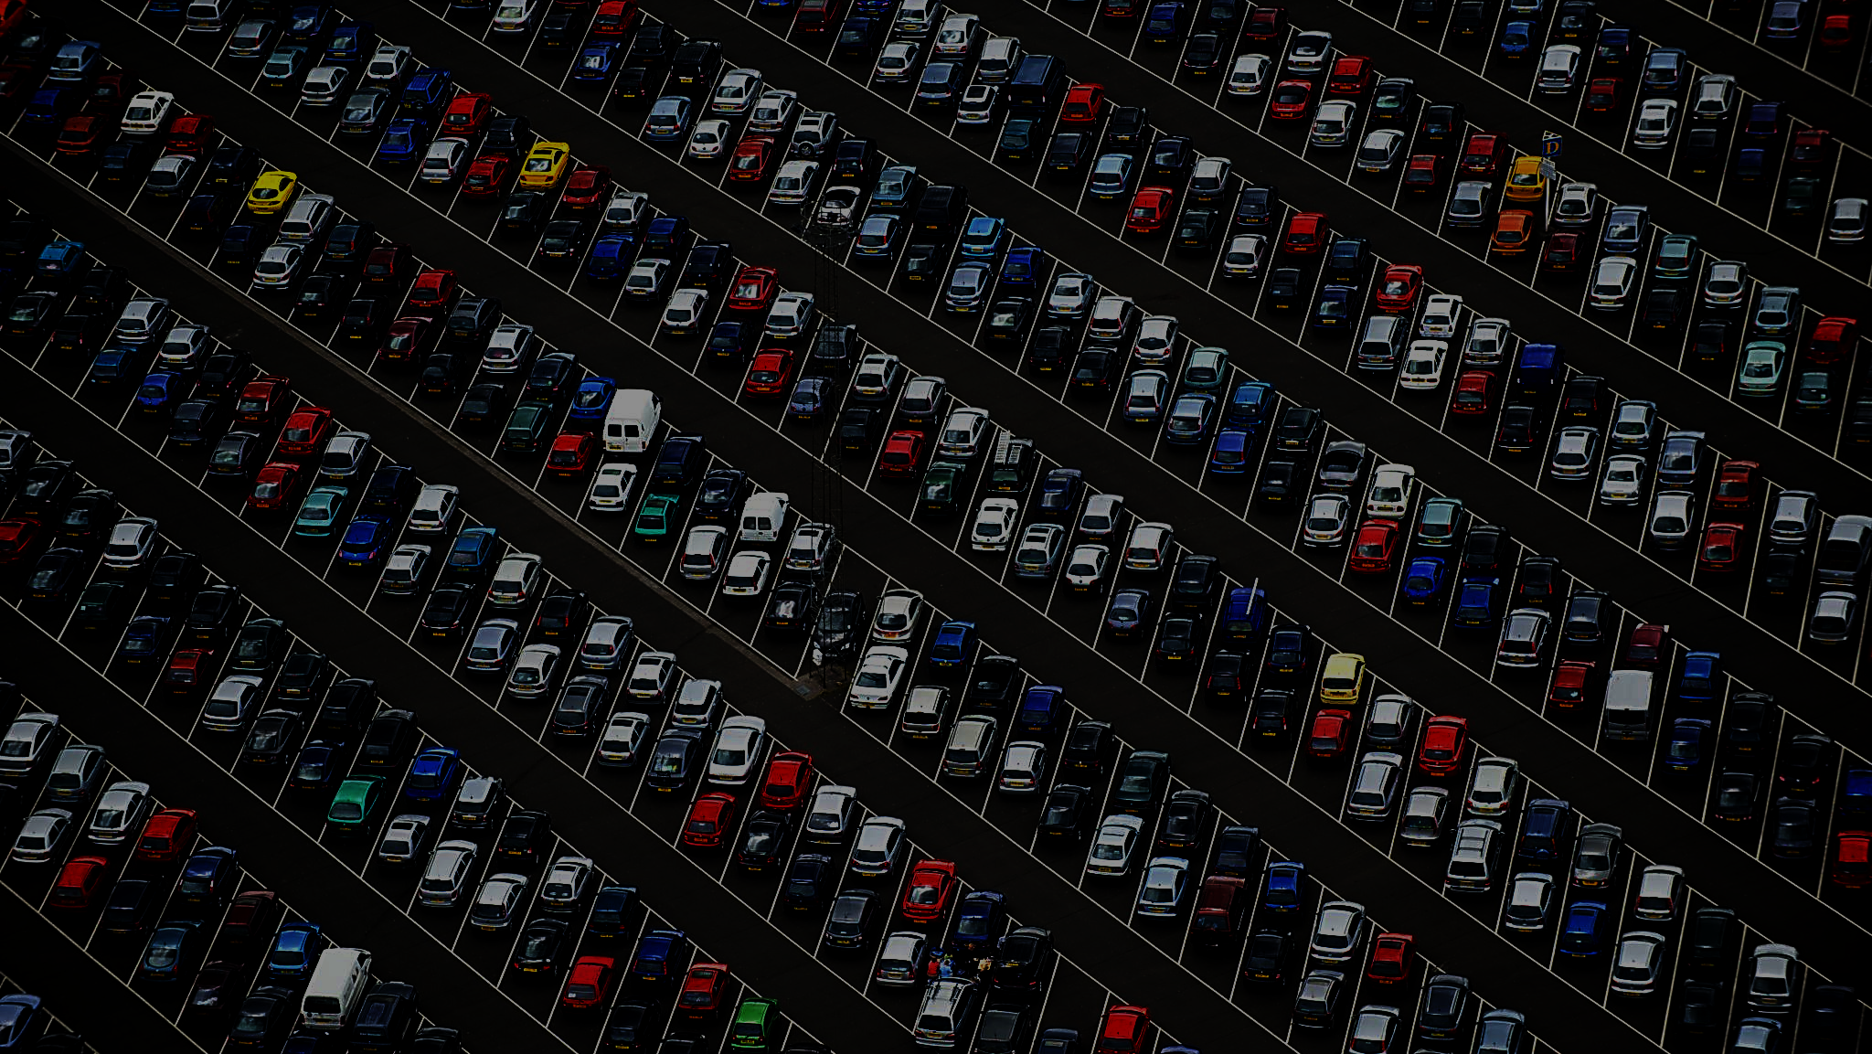
Introduction
explains the problems with the current system that led us to create a website that addresses these issues, as well as the objectives of the new system and the methodology that will be used.

Slide 4

Problem Statement
"Our retail store is currently using a manual cash register system to process transactions, which is causing delays during peak hours and making it difficult to accurately track inventory. We would like to implement a new POS system that integrates with our inventory management software, is able to handle multiple transactions at once, and includes features such as customer loyalty programs and the ability to process returns and exchanges. The system should also be user-friendly for both customers and employees

Slide 5
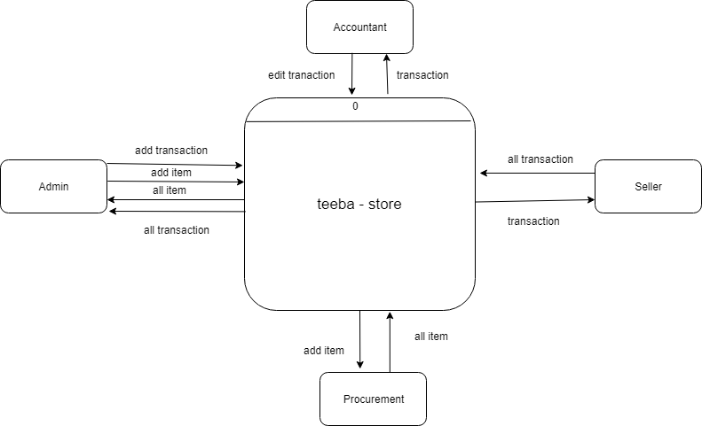
Design Model
Context Diagram

Slide 6
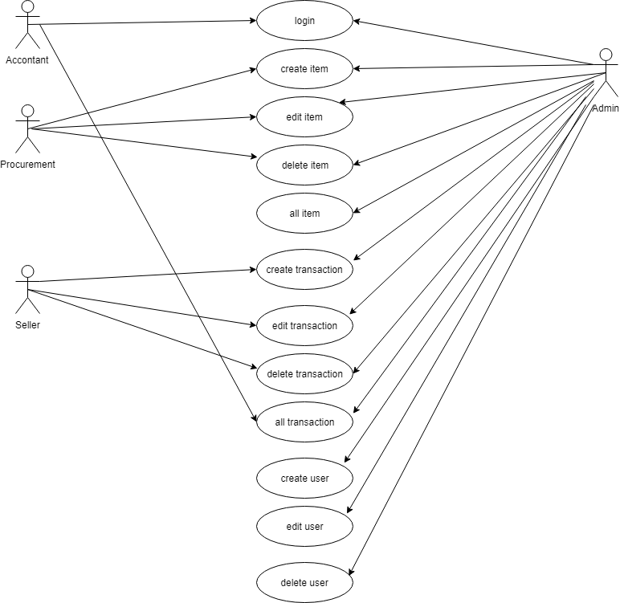
Design Model
Use Case Diagram

Slide 7
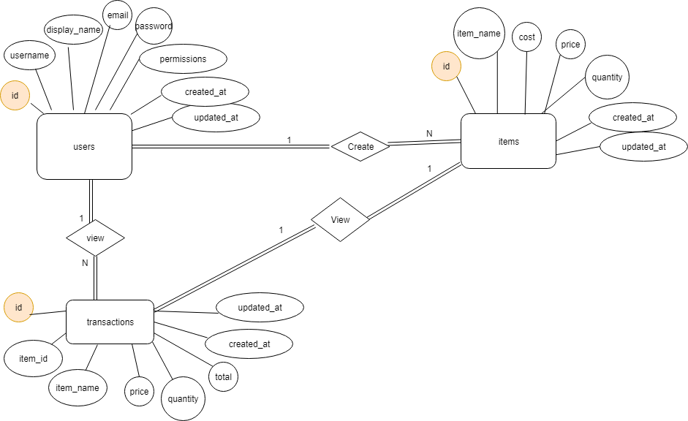
Design Model
ER Diagram

Slide 8
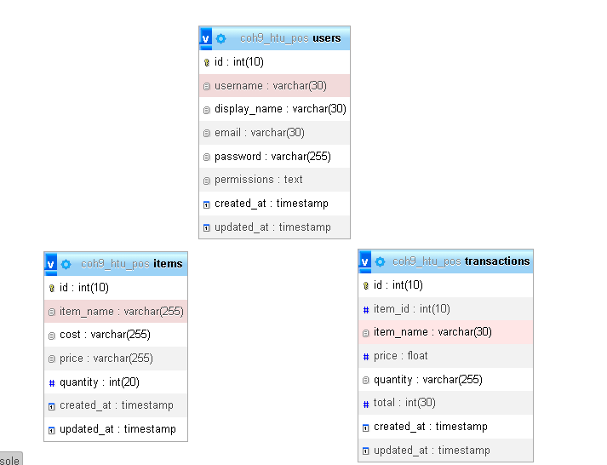
Design Model
Schema Diagram

Slide 9


